Slide 1



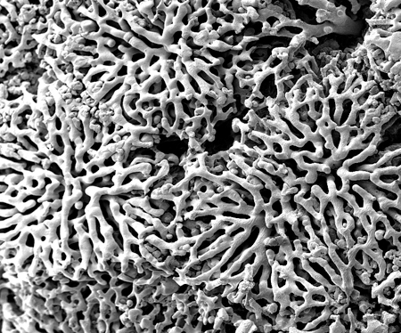
Hepatic zonation of Glucose Metabolism
Matthias König
Berlin, 2013-03-11

Slide 2
Liver Architecture On a Tissue-scale

Slide 3
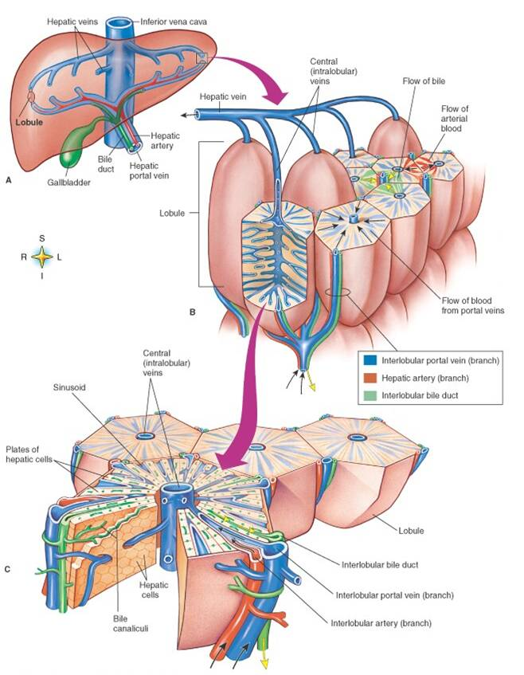
Liver Lobule
liver structured in identical subunits liver lobule
dual blood supply
80% poorly oxygenated venous blood via portal vein
20% well oxygenated via hepatic artery
blood flows via sinusoids towards central vene
pp → pv

Slide 4
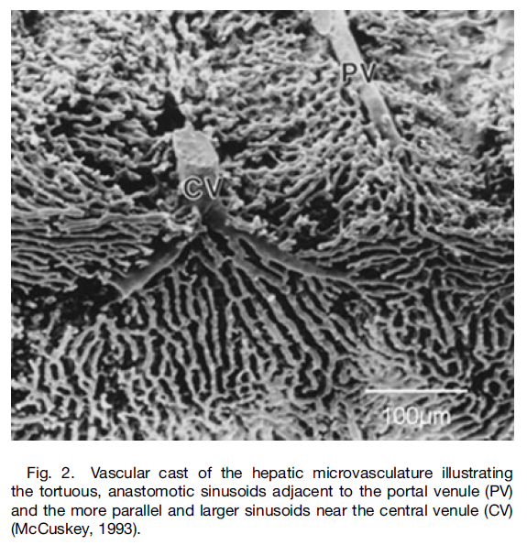
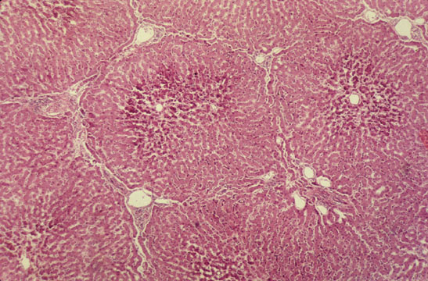

Slide 5
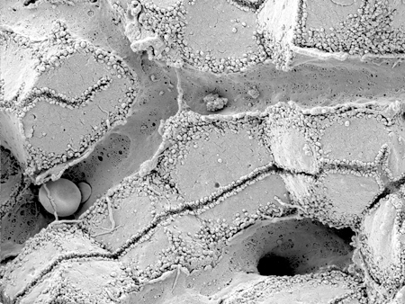
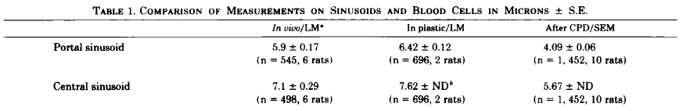
Sinusoid
Scanning electron micrograph showing fenestrated sinusoids and hepatocytes in a mouse liver.
http://www.easloffice.eu/jhep/contest/website/see_photos.html
principal vessels for exchange between blood and hepatocytes
~ 6-8µm diameter
periportal sinusoids are narrower and more tortuous than the wider and straighter central ones
Sinusoid network is heterogeneous
near portal vene arranged as interconnecting polygonal networks
farther away from portal vein organized as parallel vessels terminating in the central vein
short intersinusoidal sinusoids connect adjacent parallel sinusoids
Scanning electron microscope observations on the structure of portal veins, sinusoids and central veins in rat liver. Wisse, E.; De Zanger, R. B.; Jacobs, R. & McCuskey, R. S.; Scan Electron Microsc, 1983, 1441-1452
The liver sieve: considerations concerning the structure and function of endothelial fenestrae, the sinusoidal wall and the space of Disse. Wisse, E.; De Zanger, R. B.; Charels, K.; Van Der Smissen, P. & McCuskey, R. S. Hepatology, 1985, 5, 683-692

Slide 6
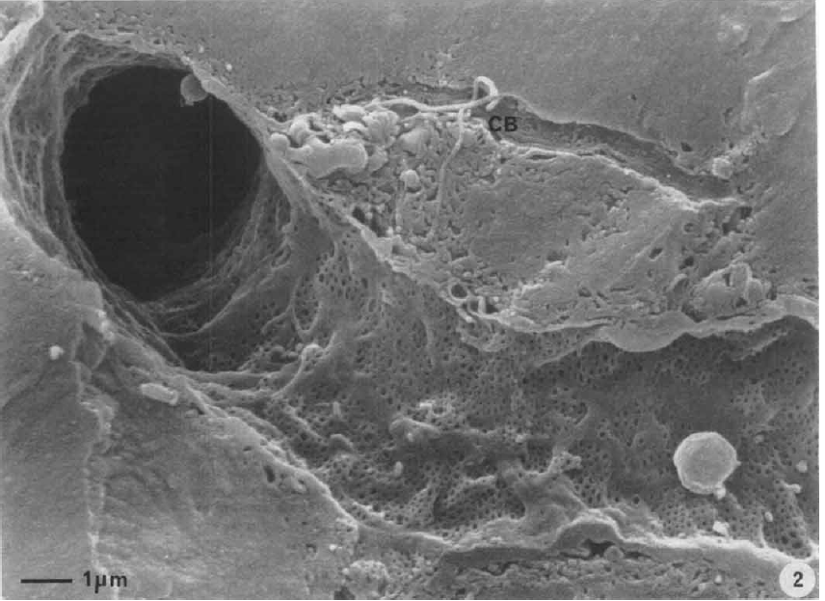
Endothelial Fenestrae
liver sinusoids unique capillaries
open pores (fenestrae) in sinusoidal wall
lack basal membrane underneath endothelium
fenestrae act as sieving barrier between blood and heptocytes
morphological & physiological evidance that fenestrae act as a dynamic filter
important role in lipid metabolism (namely chylomycrons)
Liver sinusoidal endothelial cells (LSEC) constitute sinusoidal wall
numerous endocytotic vesicles
effective uptake of a wide variety of substances from blood via receptor-mediated endocytosis (Braet, 2004)
transcytosis transport across the endothelium to surrounding tissue
scavenger system
Contribution of high-resolution correlative imaging techniques in the study of the liver sieve in three-dimensions. Braet, F. et al; Microsc Res Tech, 2007, 70, 230-242
Structural and functional aspects of liver sinusoidal endothelial cell fenestrae: a review. Comp Hepatol, Braet, F. & Wisse, E., 2002, 1, 1
The liver sieve: considerations concerning the structure and function of endothelial fenestrae, the sinusoidal wall and the space of Disse. Wisse, E.; De Zanger, R. B.; Charels, K.; Van Der Smissen, P. & McCuskey, R. S. Hepatology, 1985, 5, 683-692

Slide 7
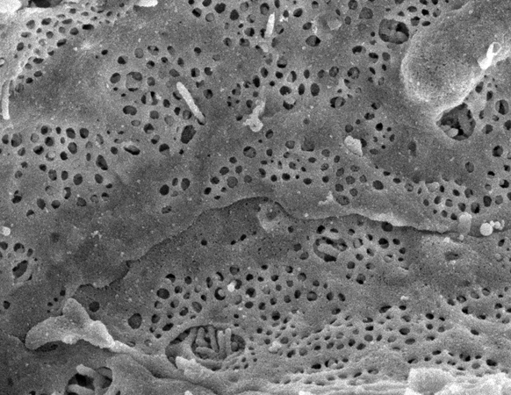
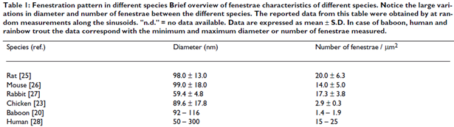
Fenestrae
Scanning electron micrograph of hepatocyte microvilli protruding through the sinusoidal endothelial cell fenestrations.
diameter ~50-200nm
ultrastructure same across species
groups of fenestrae arranged in so called sieve plates
differences periportal & perivenious
diameter decreases (110.7 to 104.8nm)
frequency increases (9 to 13 per µm²)
increased porosity from pp to pv from 6 to 8%
number and diameter may vary between individuals & within single indiviuum under various physiological and pharmacological circumstances

Slide 8
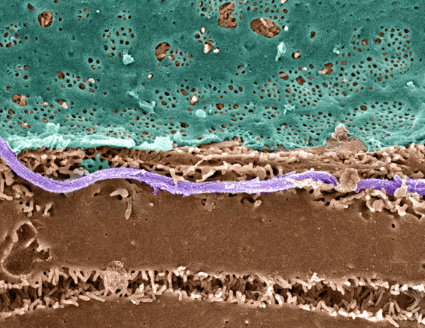
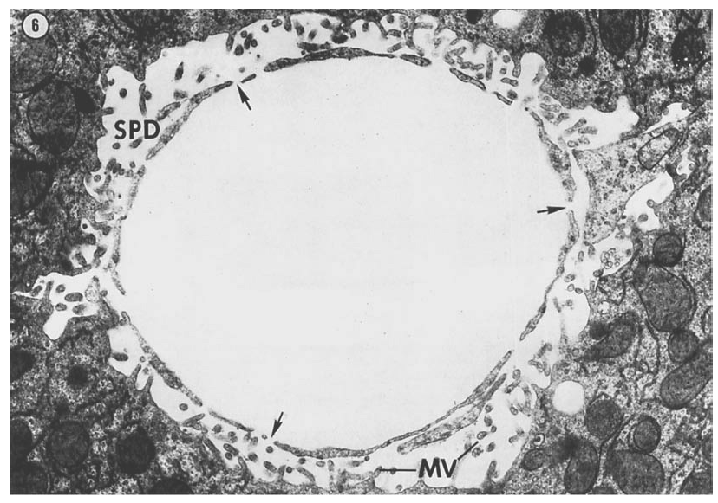
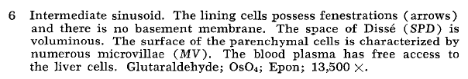
Space of Dissé
Pseudo-colored Scanning EM of an hepatic plate, accentuating the fenstrated sinuoidal endothelium (blue), hepatocyte (brown) and a collagen fibril (lavender).
Hepatocytes surface enlarged via microvilli.
The fine structure of rat liver sinusoids, space of Dissé and associated tissue space. Burkel, W. E. & Low, F. N.; Am J Anat, 1966, 118, 769-783
http://www.easloffice.eu/jhep/contest/website/see_photos.html

Slide 9
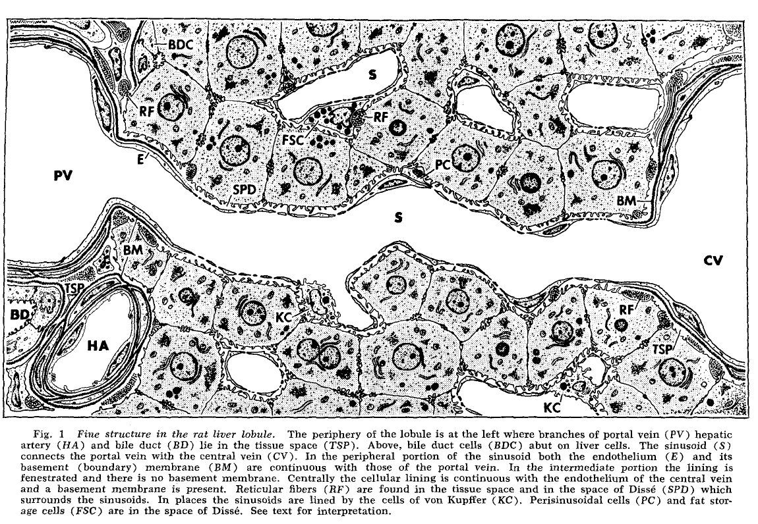
Sinusoid Ultrastructure
fenestraetion & absence of basement membranes provide direct access of blood plasma to hepatocytes
The fine structure of rat liver sinusoids, space of Dissé and associated tissue space. Burkel, W. E. & Low, F. N; Am J Anat, 1966, 118, 769-783

Slide 10
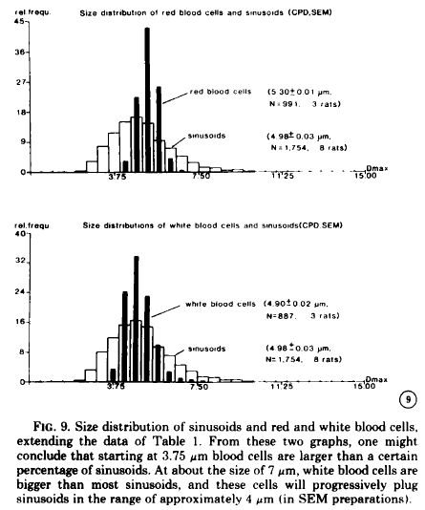
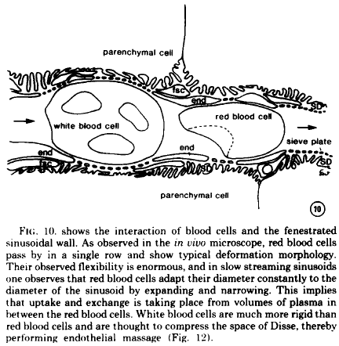
Tight Sinusoids
The liver sieve: considerations concerning the structure and function of endothelial fenestrae, the sinusoidal wall and the space of Disse. Wisse, E. et al; Hepatology, 1985, 5, 683-692

Slide 11
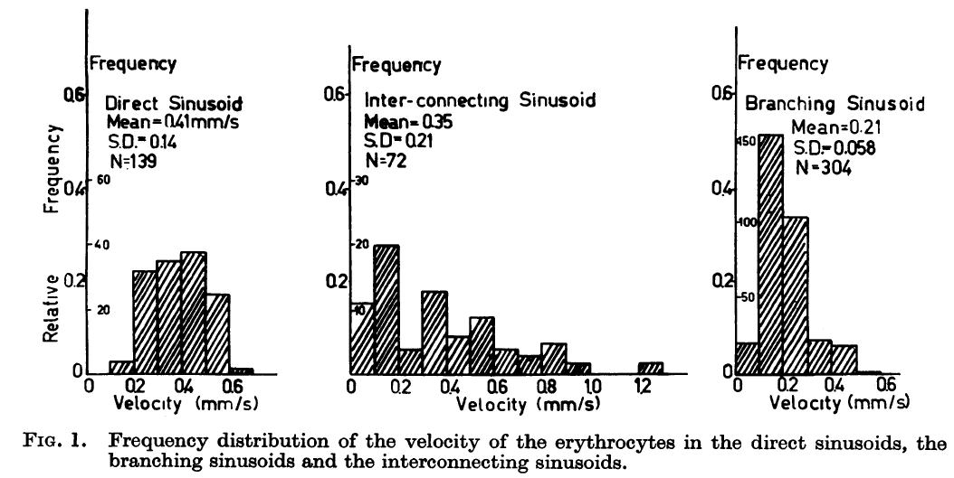
Blood Flow
The terminal hepatic microcirculation in the rat. Koo, A.; Liang, I. Y. & Cheng, K. K.; Q J Exp Physiol Cogn Med Sci, 1975, 60, 261-266
Intermittence of blood flow in liver sinusoids, studied by high-resolution in vivo microscopy. MacPhee, P. J.; Schmidt, E. E. & Groom, A. C.; 1995, 269, G692-G698

Slide 12
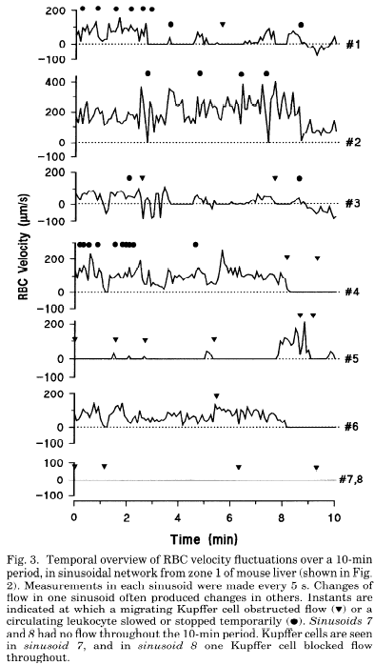
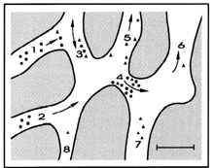
Blood Flow
The terminal hepatic microcirculation in the rat. Koo, A.; Liang, I. Y. & Cheng, K. K.; Q J Exp Physiol Cogn Med Sci, 1975, 60, 261-266
Intermittence of blood flow in liver sinusoids, studied by high-resolution in vivo microscopy. MacPhee, P. J.; Schmidt, E. E. & Groom, A. C.; 1995, 269, G692-G698

Slide 13
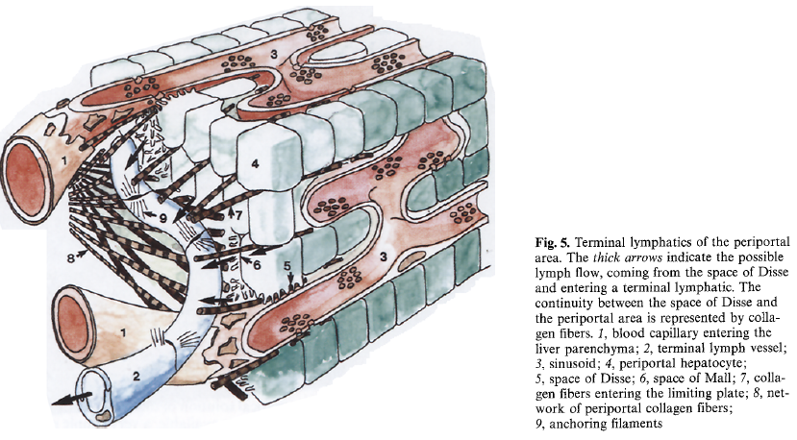
Lymph
substantial amount of hepatic lymph is generated in space of Dissé
space of Dissé is continuos with the tissue space at both ends of the sinusoid !
high protein content of hepatic lymph
lymphatic vessels originate as blind-ending capillaries in the connective tissue spaces (portal tracts) associated with the portal veins and hepatic arteries
fluid contained in these lymphatics flows toward the hepatic hilus and eventually into the cisternae chyli
Lymph circulation in the liver. Ohtani, O. & Ohtani, Y.; Anat Rec; 2008, 291, 643-652
The lymphatics of the liver. Trutmann, M. & Sasse, D. ; Anat Embryol (Berl), 1994, 190, 201-209

Slide 14
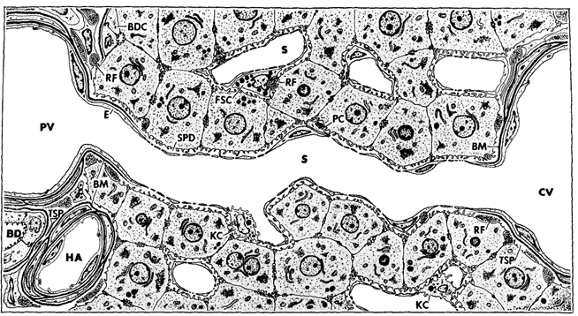
Metabolic zonation of Glucose metabolism

Slide 15
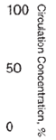
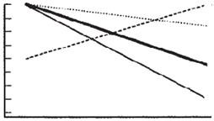
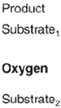
Zonated Metabolites
production/utilization by hepatocytes along sinusoid
depending on hepatic metabolism & exchange
glucose & lactate between 10-50% increase/decrease
O2 ~50% decline with strong longterm & shortterm effects of O2 on glucose metabolism
Role of oxygen in the zonation of carbohydrate metabolism and gene expression in liver. Jungermann, K. & Kietzmann, T. Kidney Int, 1997, 51, 402-412
Long-term effects of physiological oxygen concentrations on glycolysis and gluconeogenesis in hepatocyte cultures. Wölfle, D. & Jungermann, K.; Eur J Biochem, 1985, 151, 299-303

Slide 16
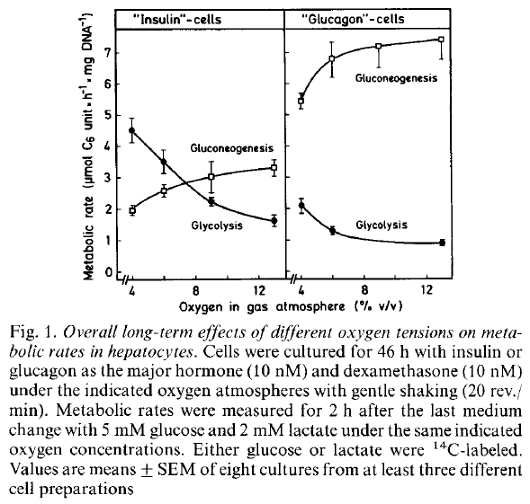
Zonated Metabolites
production/utilization by hepatocytes along sinusoid
depending on hepatic metabolism & exchange
glucose & lactate between 10-50% increase/decrease
O2 ~50% decline with strong longterm & shortterm effects of O2 on glucose metabolism
Role of oxygen in the zonation of carbohydrate metabolism and gene expression in liver. Jungermann, K. & Kietzmann, T. Kidney Int, 1997, 51, 402-412
Long-term effects of physiological oxygen concentrations on glycolysis and gluconeogenesis in hepatocyte cultures. Wölfle, D. & Jungermann, K.; Eur J Biochem, 1985, 151, 299-303

Slide 17
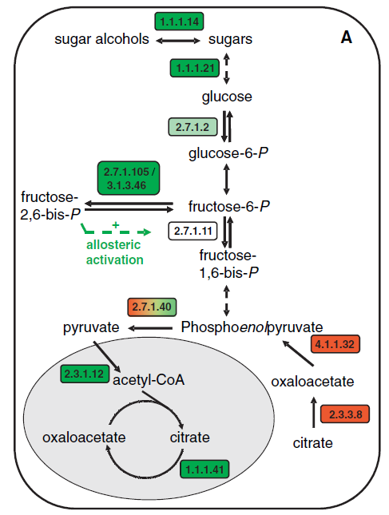
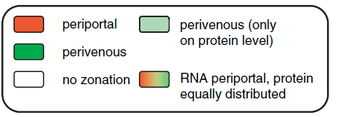
Zonated Gene Expression
Differential gene expression in periportal and perivenous mouse hepatocytes. Braeuning, A. et al.; , 2006, 273, 5051-5061

Slide 18
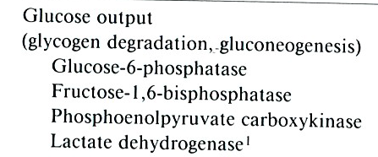
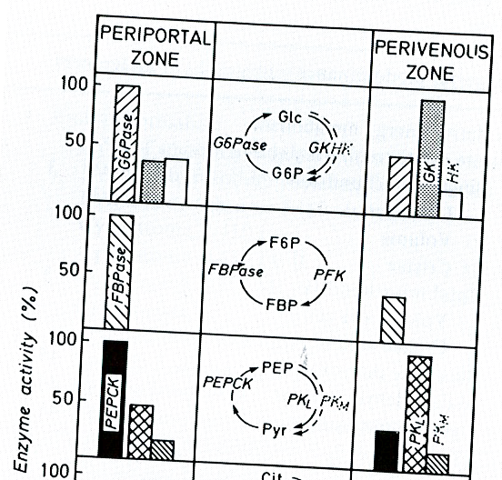
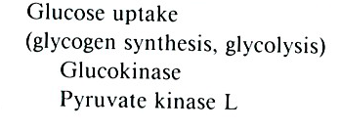
Zonated Protein Levels
Functional heterogeneity of periportal and perivenous hepatocytes. Jungermann, K.; Enzyme, 1986, 35, 161-180

Slide 19
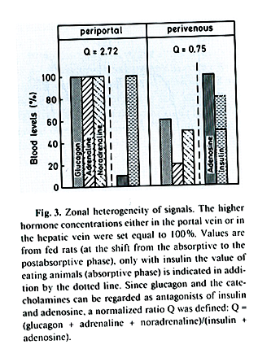
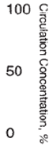
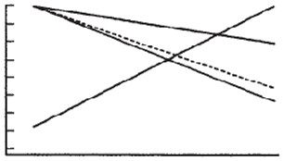
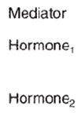
ZonatED Signalling
Hormonal gradients
liver main role in clearance of hormones
insulin (85-50% fasting, postprandial)
glucagon (~50%) & epinephrine
but also producer of hormones
large adenosine gradient
changing ratio (glucagon+epinephrine)/insulin
Hepatocyte heterogeneity in the metabolism of carbohydrates. Jungermann, K. & Thurman, R. G.; Enzyme, 1992, 46, 33-58

Slide 20
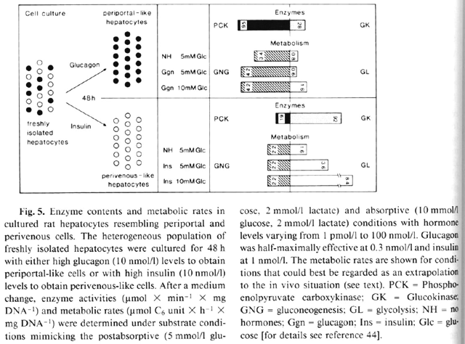
Induction of pp/PV via Insulin & Glucagon
Hepatocyte heterogeneity in the metabolism of carbohydrates. Jungermann, K. & Thurman, R. G.; Enzyme, 1992, 46, 33-58

Slide 21
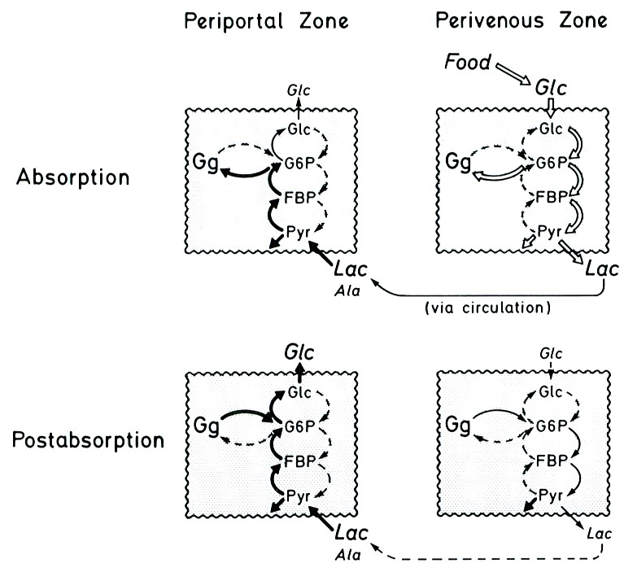
Zonated Glucose Metabolism
Functional heterogeneity of periportal and perivenous hepatocytes. Jungermann, K.; Enzyme, 1986, 35, 161-180

Slide 22
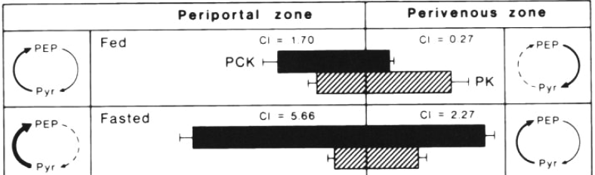
Dynamic Zonation
Adaptations of zonation depending on physiological state
fed -> fast transition associated with decreasing insulin & increasing glucagon
hormone/oxygen dependent expression
adapting enzyme activities via hormone gradients on longer time scale (expresson signal integrator over the last hours)
in addition to fast regulation via interconvertible enzymes
Hepatocyte heterogeneity in the metabolism of carbohydrates. Jungermann, K. & Thurman, R. G.; Enzyme, 1992, 46, 33-58

Slide 24
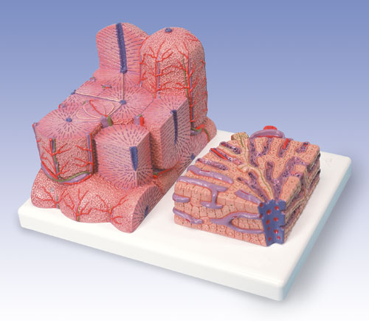
Liver Lobulus

Slide 25
Heterogeneous sinusoid network
near portal vene and hepatic artery sinusoids are arranged in interconnecting polygonal networks
farther away from the portal vein the sinusoids become organized as parallel vessels terminating in the central vein
short intersinusoidal sinusoids connect adjacent parallel sinusoids

Slide 26
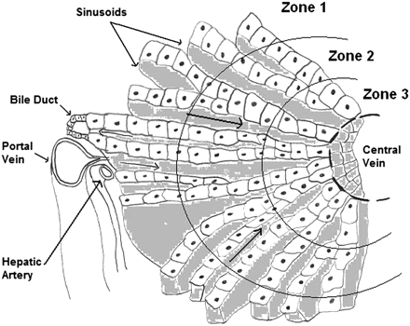
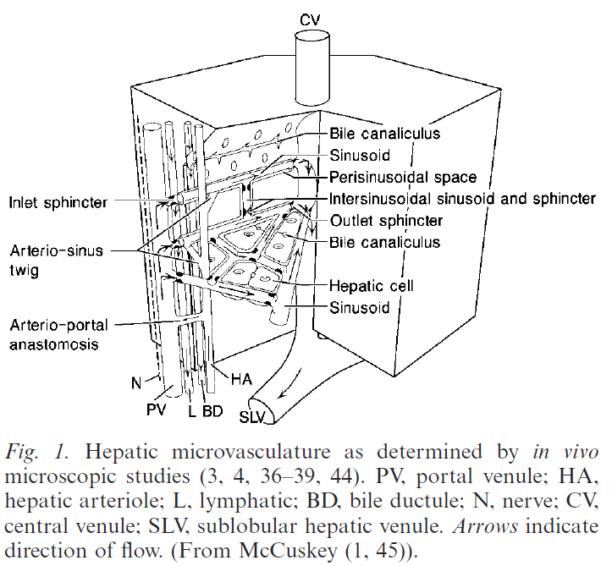
Varying heptatocyte metabolism from pp to pv (zonation)
glucose metabolism
nitrogen metabolism
fatty acid metabolism
detoxification

Slide 27
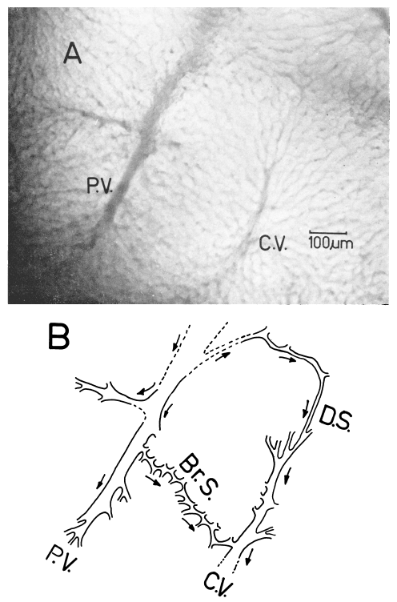
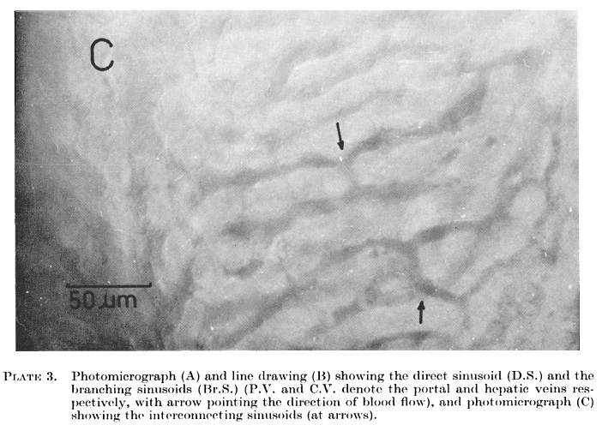

Slide 28
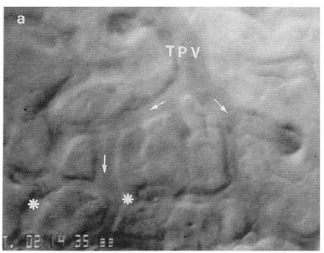
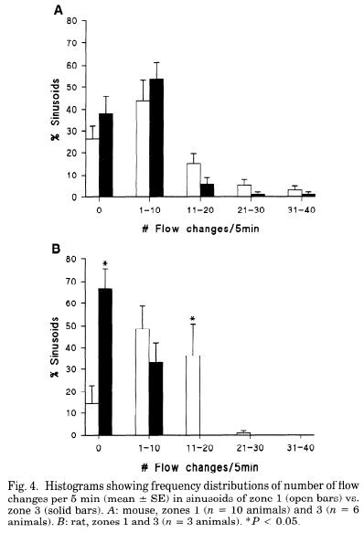
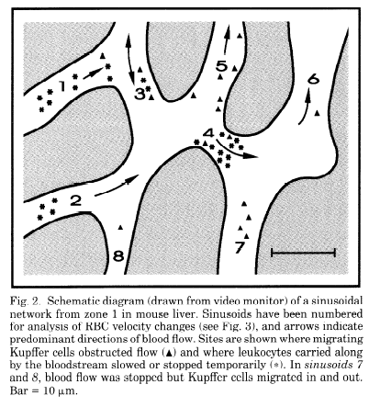
Blood Flow ?
Intermittence of blood flow in liver sinusoids, studied by high-resolution in vivo microscopy. MacPhee, P. J.; Schmidt, E. E. & Groom, A. C.; 1995, 269, G692-G698

Slide 29
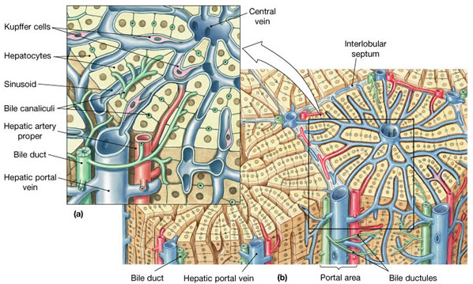
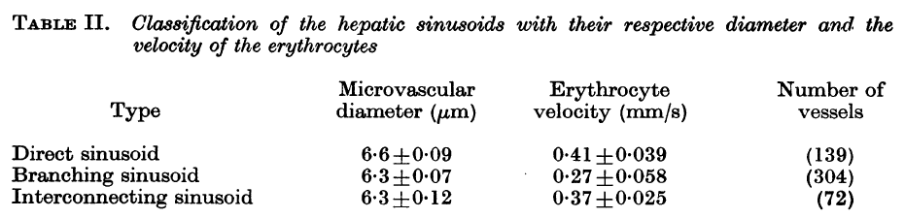

Slide 30
Overview
Liver architecture (structural properties)
zonated architecture
blood flow rates, diameters, ...
lymph?
Metabolic zonation of glucose metabolism
differences in enzyme activities (pp, pv)
differences in fluxes (pp, pv)
model of metabolic zonation in glucose metabolism
dynamic zonation of metabolism

Slide 31
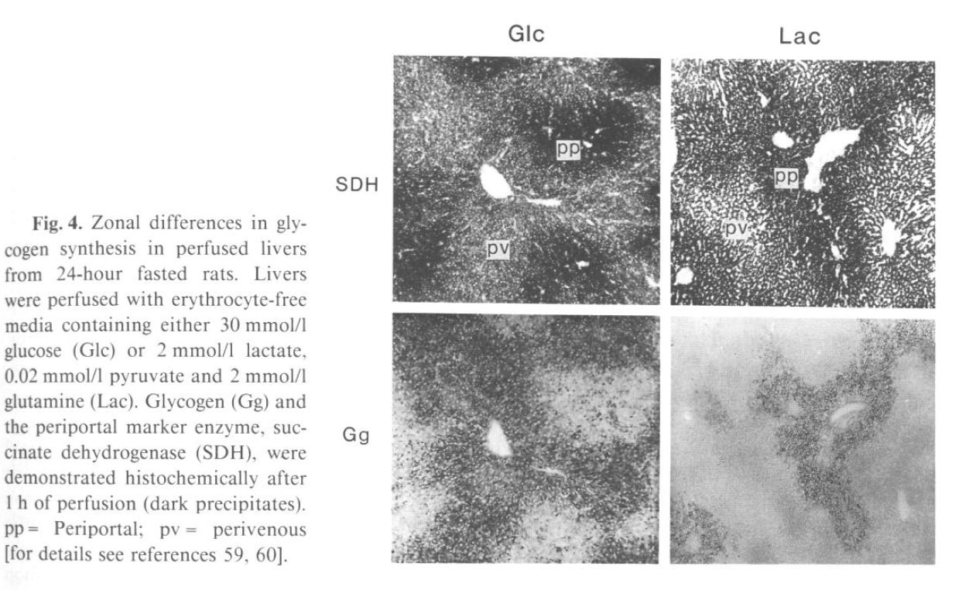
Heterogeneous Glycogen Metabolism
zonated glycogen synthesis & degradation

Slide 32
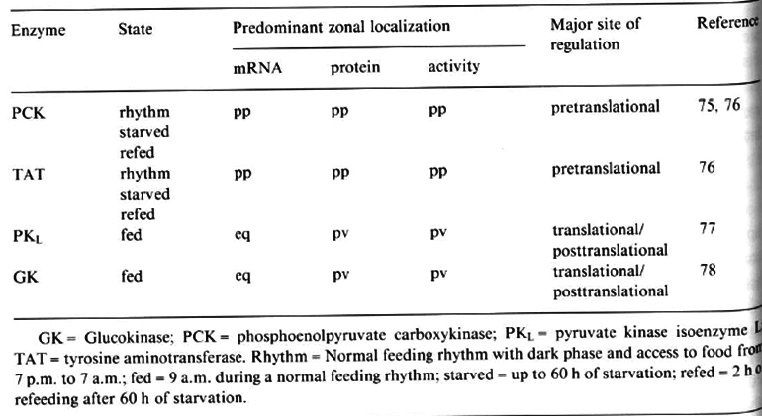

Slide 33
Comparison to Other Zonated Kinetic Models
Chalhoub et al., 2007
Gold Standard: zonated glucose metabolism based on detailled single cell kinetic model integrated in flux model of sinusoid (1D) with variations in enzyme activity
BUT:
no hormons & hormonal control
metabolic model of glucose metabolsim is not very well validated against any physiological data (original Chaloub model) ?
no pp/pv experimental data reproduced, metabolic zonation & cooperation between pp & pv not shown (validation via 1 data point for net glucose production & net lactate uptake?)
Ricken et al., 2013?
Reduced kinetic model of glucose metabolism integrated in Ricken-Type model with blood flow (2D)
BUT: no zonated protein levels

Slide 34
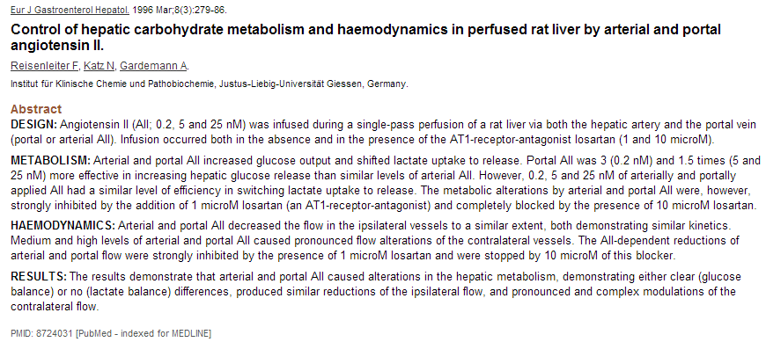
Blood Flow as regulator

Slide 35
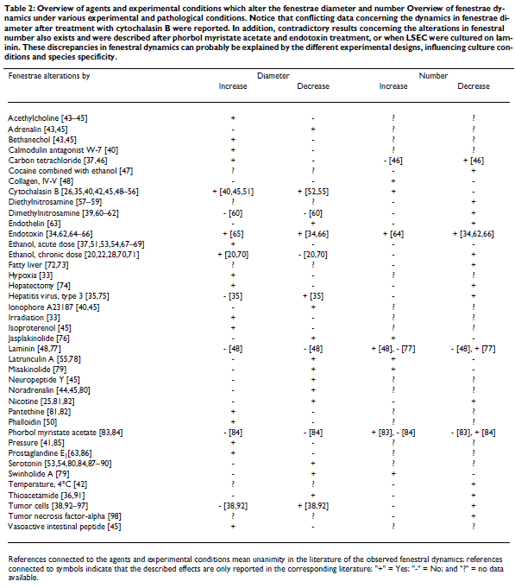
Fenestrae & Cholesterol
According to information available to date, it seems likely that variations in fenestration pattern between different species may explain the susceptibility of different species to dietary cholesterol.
For example, in comparison with the rat, rabbits have smaller fenestrae and chickens have fewer fenestrae. Thus, both species have a liver sieve of lower porosity than the rat, resulting in a prolonged circulation of cholesterol-rich chylomicrons which are considered to be atherogenic.
This correlates well with the vulnerability of rabbits and chickens to dietary cholesterol, resulting in hyperlipoproteinemia and the development of atherosclerosis [22–24] (see also § Role of fenestrae in lipoprotein metabolism and atherosclerosis).
To date, a widely accepted hypothesis stipulates that drugs which dilate fenestrae, such as pantethine, acethylcholine or ethanol improve the extraction of dietary cholesterol from the circulation; whereas drugs such as nicotine, longterm ethanol abuse, adrenalin, noradrenalin or serotonin, which decrease the endothelial porosity, play a role in the development of drug- and stress-related atherogenesis. Fraser et al. [32] demonstrated that drugs which alter the fenestral diameter and number also affect the pathogenesis of atherosclerosis, by increasing or decreasing the access of atherogenic lipoproteins to the hepatocytes.

Slide 36


Slide 37

Dynamic zonation
Ruijter2004

Slide 38
Arterial blood enters some of the sinusoids, principally through branches of the hepatic arterioles
these vessels, arterio-sinus twigs, terminate in sinusoids near the origins from portal venules (McCuskey2000)
Studies using 3D reconstruction of sectioned livers, scanning electron microscopic examination of corrosion casts and in vivo microscopy of several species (9-12) support Matsumoto‘s concept of th functional unit being a conical microvascular subunit of the classic lobule [13]
these „primary lobules“ were renamed „hepatic microvascular subunits (HMS)“ and were demonstrated to consist of a group of sinusoids supplied by a single inlet venule

Slide 39
Scanning electron micrograph of hepatocyte microvilli protruding through the sinusoidal endothelial cell fenestrations.
Scanning electron micrograph of a vascular corrosion cast illustrating the complex network of hepatic sinusoids in a mouse liver.

Slide 40



Slide 41



fenestrae have dimension of ~100-200nm and appear to be membrane bound cytoplasmic holes (Braet et al., 1994)
ultrastructure of LSEC is the same across species, i.e. long cytoplasmatic extensions containing fenestrae clustered in sieve plates
number and diameter of fenestrae may vary between individuals, and within a single indiviuum under various physiological and pharmacological circumstances
How molecular microscopy revealed new insights into the dynamics of hepatic endothelial fenestrae in the past decade. Braet, F.; Liver Int, 2004, 24, 532-539

Slide 42
Hepatic Microvascular Subunits
Currently, the concept of subunits of the classic lobule forming functional units is the most consistent with existing evidence (Matsumoto and Kawakami, 1982; Ekataksin and Wake, 1997; Ekataksin et al., 1997; Ekataksin 1999).
In this model, each ‘‘classic’’lobule consists of several ‘‘primary lobules’’.
Each primary lobule is cone-shaped, having its convex surface at the periphery of the classic lobule supplied by terminal branches of portal venules and hepatic arterioles, and its apex at the center of the classic lobule drained by a central (terminal hepatic) venule.
These ‘‘primary lobules’’ were renamed as ‘‘hepatic microvascular subunits (HMS)’’ and were demonstrated to consist of a group of sinusoids supplied by a single inlet venule and its associated termination of a branch of the hepatic arteriole from the adjacent portal space.
Hepatocellular metabolic gradients also have been demonstrated to conform to this proposed functional-unit concept (Teutsch1992, Teutsch1999)
McCuskey2008

Slide 43
The frequency distribution of the wide variations in blood flow in the sinusoids exhibits a polymodal pattern composed of several Gaussian distributions (30).
These wide variations in flow are due to the structural features previously described for sinusoids and are also due to intermittent arterial inflow into the sinusoids (3, 4, 34).
Blood pressure in portal and central venules has been measured to be about 6 to 7 cm H2O and 1.5 to 3.0 cm H2O, respectively (14, 15). Arterial blood enters the sinusoid at pressures ranging from 12 to 25 cm H2O (34). (McCuskey2000)

Slide 44
Blood Flow Regulation
multiple sites of regulation of blood flow to and from the sinusoids in hepatic microvascular system
various sinusoidal lining cells have been suggested to play a role in regulating the diameters of sinusoids & influencing the distribution and velocity of blood flow in these vessels

Slide 45



Representative Fields

Slide 46
Sinusoid Diameter
size distribution & blood flow distributions
good correlation between size and diameter
5.7µm (Chalhoub et al., 2007)

Slide 47


Architectural Parameters
Resulting architectural parameters for tissue-scale model

